Slide 1
Design of Secure Authenticated Key Management Protocol for Cloud Computing Environments

Slide 2
Abstract
To convenient access to the services and protect the privacy of communication in the public network, three-factor Mutual Authentication and Key Agreement (MAKA) protocols for multi-server architectures gain wide attention.
three-factor MAKA protocols haven’t a dynamic revocation mechanism, which leads to malicious users can not be promptly revoked.
To address these drawbacks, we propose a provable dynamic revocable three-factor MAKA protocol that achieves the user dynamic management using Schnorr signatures and provides a formal security proof in the random oracle.

Slide 3
EXISTING SYSTEM
Earlier MAKA protocols are designed for single-server architecture. As Internet users grow exponentially, the number of cloud servers rendering different services has also grown significantly. For the single-server architecture, it is difficult for users to maintain a variety of passwords for each server.
To improve user experience, many scholars propose more flexible MAKA protocols for multi-server environments. Combined with the unified management features of the cloud platform, such protocols can be conveniently applied. users and cloud servers only need to register in the registration center (RC) to mutual authentication and key agreement.

Slide 4
Disadvantages
In the multi-server environments, the MAKA protocols can be further divided into two categories, two-factor MAKA protocols, namely identity, password, and three-factor MAKA protocols, namely identity, password, biometrics. The works in have shown that the password- based MAKA protocols suffer from several attacks such as guessing password attack.

Slide 5
PROPOSED SYSTEM
We design a three-factor MAKA protocol which implements three-factor security. And we show that the proposed protocol can meet the demands of multi-server architectures such as anonymity, non traceability, resistance password guessing attack and smart card extraction attack, and so on.
Our scheme achieves the user’s dynamic management. In our protocol, users can be dynamically revoked to promptly prevent attacks from malicious users. Without a dynamic revocation mechanism, RC can’t punish malicious users in a timely manner. This may result in such malicious users still active in the network to communicate with other servers.

Slide 6
In the random oracle, we provide a formal proof of the proposed protocol based on BDH, CDH and Schnorr signatures un forgeability assumptions. We show that the proposed protocol is mutual authentication secure and authenticated key agreement secure. 4) Our protocol has a good execution efficiency. Especially on the client side, the computation cost of our scheme is the lowest in the related existing protocols. This shows that our protocol is more suitable for device mobiles with limited computing resource. And, to prove that the protocol is technically sound, we programmatically simulate the proposed protocol.

Slide 7
Advantages
Proposed a biometrics based MAKA protocol for multi-server environments. Unfortunately, after our analysis in the security comparisons and cryptanalysis subsection of this paper, their protocol is vulnerable the server impersonation attack and the man-in the-middle attack. On the other hand, the MAKA protocol is also widely used in other environments, such as Passive Internet of Things.

Slide 8
System Specification
SYSTEM REQUIREMENTS
H/W System Configuration:-
➢ Processor - Pentium –IV
➢ RAM - 4 GB (min)
➢ Hard Disk - 40 GB(Min)
➢ Key Board - Standard Windows Keyboard
➢ Mouse - Two or Three Button Mouse
➢ Monitor - SVGA
Software Requirements:
Operating System - Windows XP
Coding Language - Java/J2EE(JSP,Servlet)
Front End - J2EE
Back End - MySQL

Slide 9
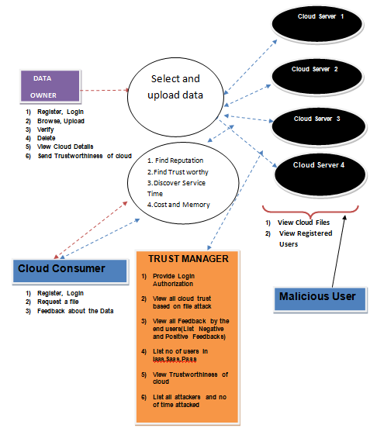
System Architecture

Slide 10
IMPLEMENTATION
DATA OWNER :
In this module, initially the data owner has to get register to the cloud
server (CS1,CS2,CS3,CS4) . Data owner will login to the corresponding cloud server he
got registered. Data owner encrypt will upload file to the cloud server (CS1, CS2, CS3,
CS4) Data owner verifies the file he uploaded either it is safe or not. Data owner can
view, how many file has been uploaded to the corresponding cloud
servers(CS1,CS2,CS3,CS4) Data owner will send file to trust manager to store the data
owner file t5o the corresponding cloud servers (CS1,CS2,CS3,CS4)
CLOUD SERVER :
The cloud server manages a cloud to provide data storage service. Data owners encrypt
their data files and store them in the cloud for sharing with cloud consumer. To access
the shared data files, data consumers download encrypted data files of their interest
from the cloud and then decrypt them.

Slide 11
TRUST MANAGER :
Trust manager provides login authorization for both data owner and the end user.
Trust manager can view all the cloud status .Trust manager can view the feed backs given
by end user and lists all positive and negative feed backs. Trust manager lists no of users in
cloud services(IAAS,PAAS,SAAS).Trust manager can view the attackers in cloud
servers(CS1,CS2,CS3,CS4) and the no of time attacked.
CLOUD CONSUMER :
Cloud consumer first has to register to the cloud server (CS1, CS2, CS3, CS4) which
particular cloud he has to use. Cloud consumer has to login to the cloud he got registered.
Cloud consumer feedback about the data (positive or negative feedback).
ATTACKER :
Attacker will view registered users and cloud files.
1. Collusion Attacks - to mislead feedbacks about the cloud
2. Sybil Attacks - When user uses more transaction per day (Exceeds the limit which is
assigned by the Trust Manager).

Slide 12
CODE
package Algorithms;
import java.math.BigInteger;
import java.nio.charset.StandardCharsets;
import java.security.MessageDigest;
import java.security.NoSuchAlgorithmException;
// Java program to calculate SHA hash value
public class HashFunction {
public static byte[] getSHA(String input) throws NoSuchAlgorithmException
{ // Static getInstance method is called with hashing SHA
MessageDigest md = MessageDigest.getInstance("SHA-256");// digest() method called
// to calculate message digest of an input
// and return array of byte
return md.digest(input.getBytes(StandardCharsets.UTF_8));
} public static String toHexString(byte[] hash)
{ // Convert byte array into signum representation
BigInteger number = new BigInteger(1, hash);
// Convert message digest into hex value
StringBuilder hexString = new StringBuilder(number.toString(16));
// Pad with leading zeros
while (hexString.length() < 32)
{ hexString.insert(0, '0');} return hexString.toString(); } }
package Algorithms;
import java.io.UnsupportedEncodingException;
import java.security.MessageDigest;
import java.security.NoSuchAlgorithmException;
import java.util.Arrays;
import java.util.Base64;
import javax.crypto.Cipher;
import javax.crypto.spec.SecretKeySpec;
public class AES {
private static SecretKeySpec secretKey;

Slide 13
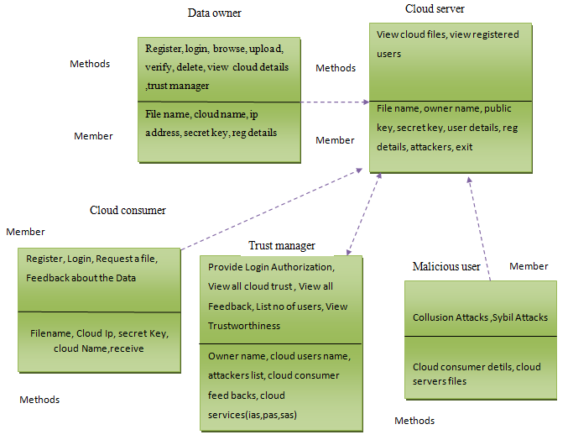
UML DIAGRAMS CLASS DIAGRAM:

Slide 14
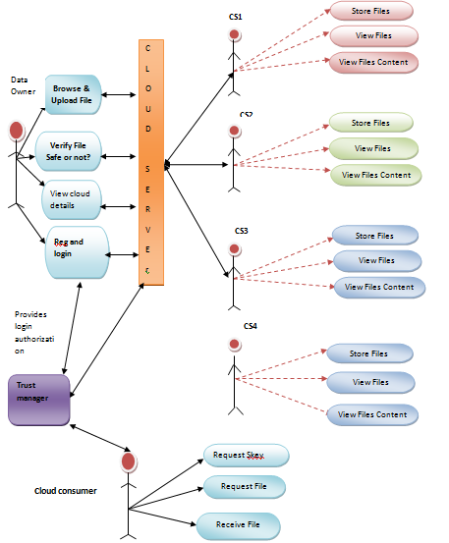
USECASE DIAGRAM:

Slide 15
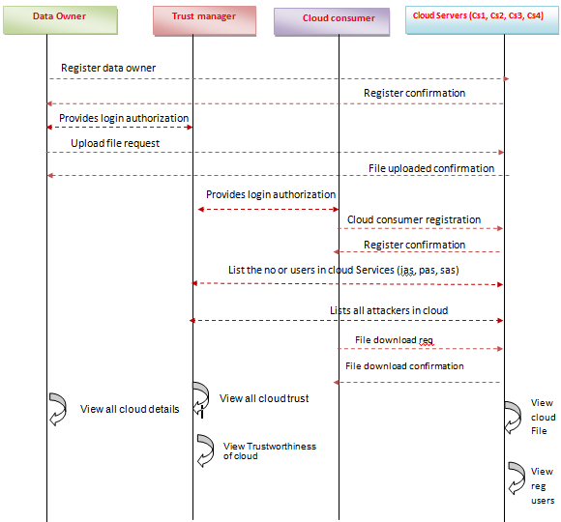
SEQUENCE DIAGRAM:

Slide 16
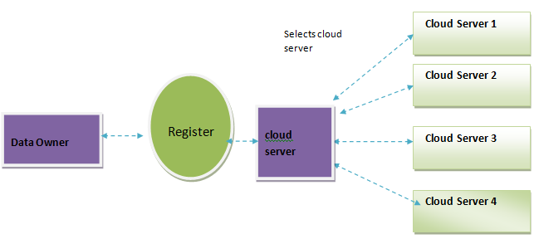
DATA FLOW DIAGRAM LEVEL 0:

Slide 17
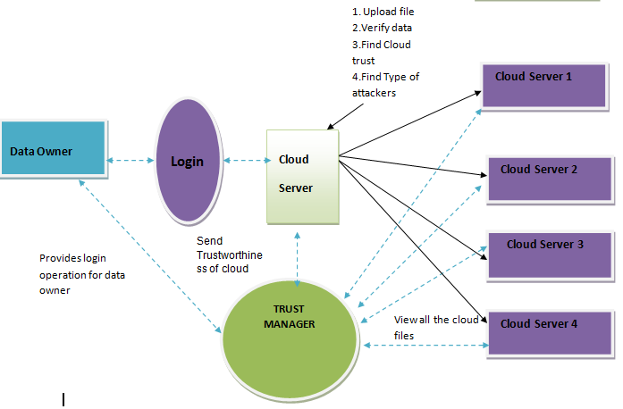
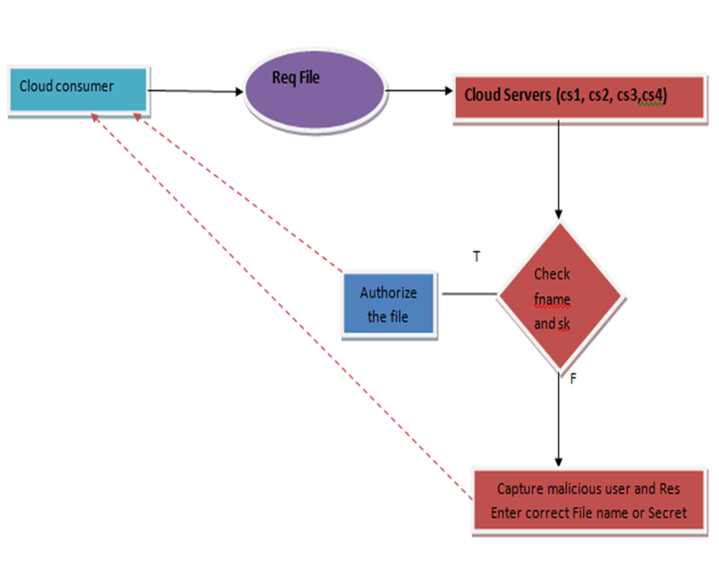
LEVEL 1: LEVEL 2:

Slide 18
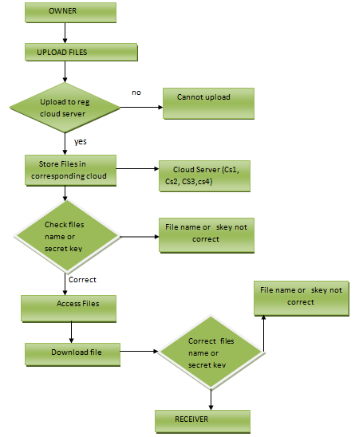
ACTIVITY DIAGRAM

Slide 19
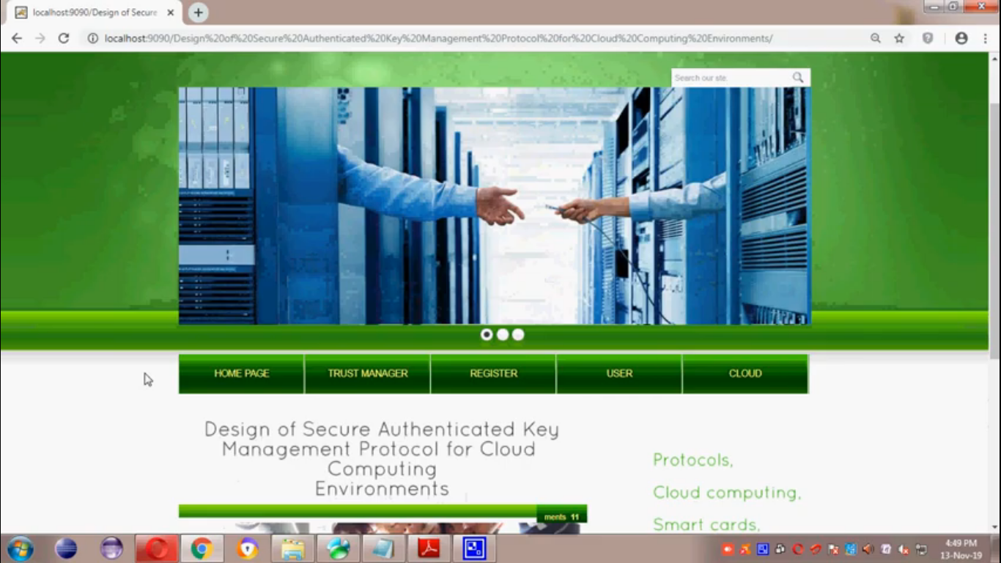
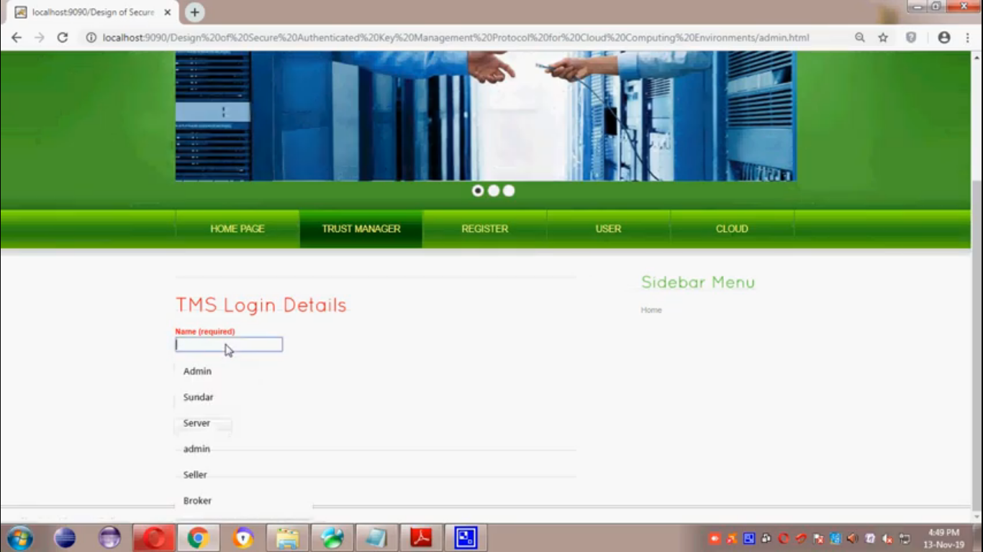
OUTPUT SCREENS

Slide 20
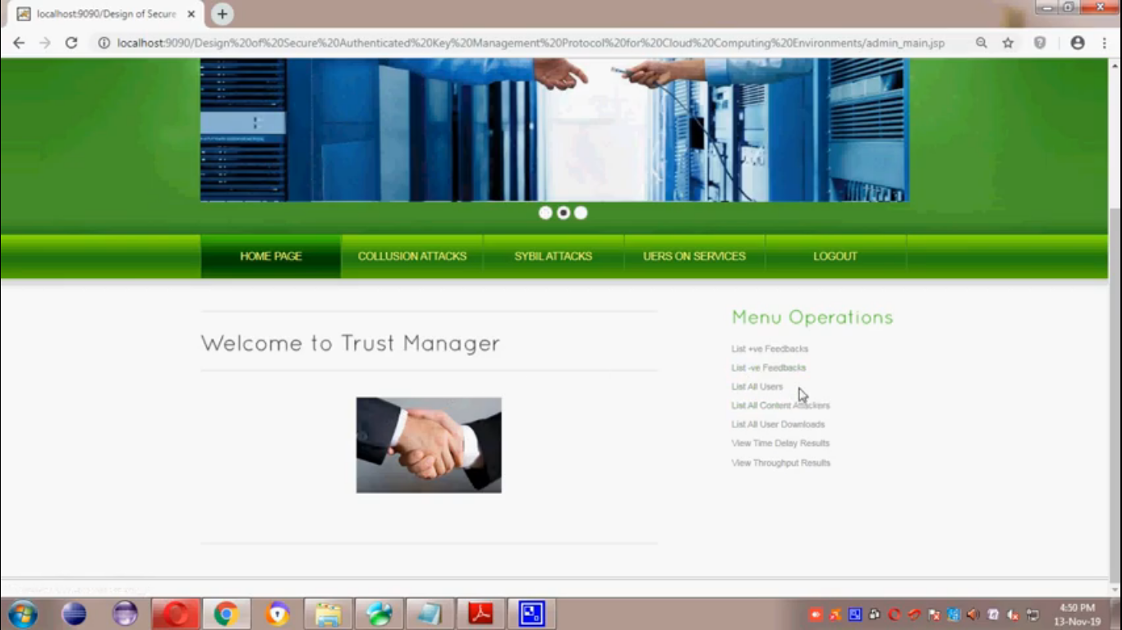
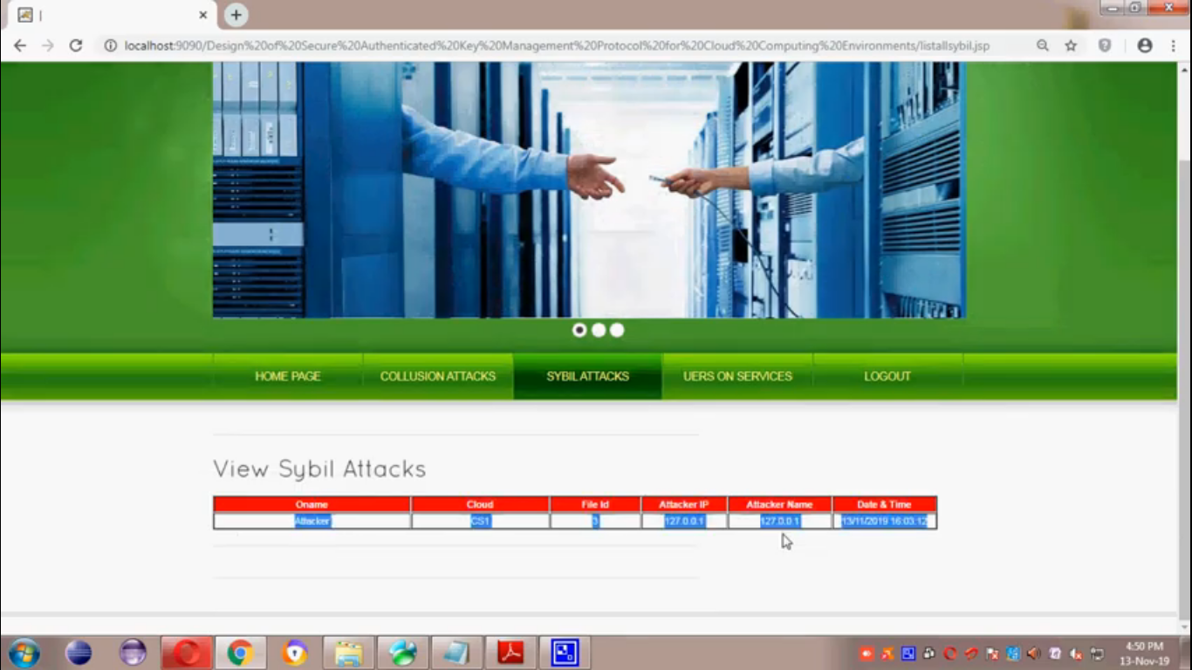
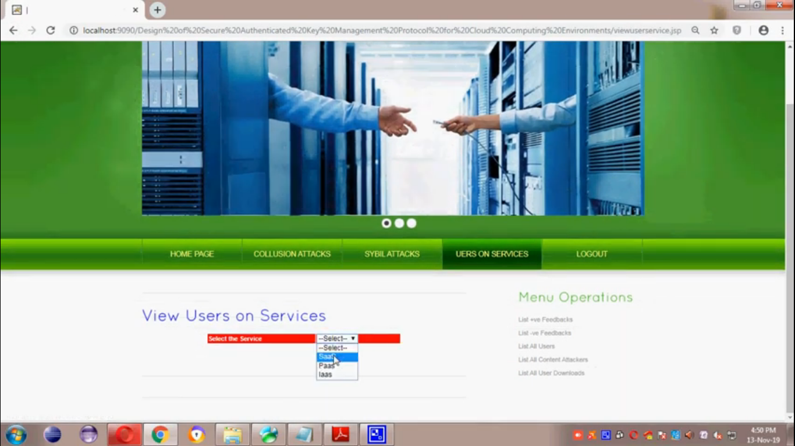

Slide 21
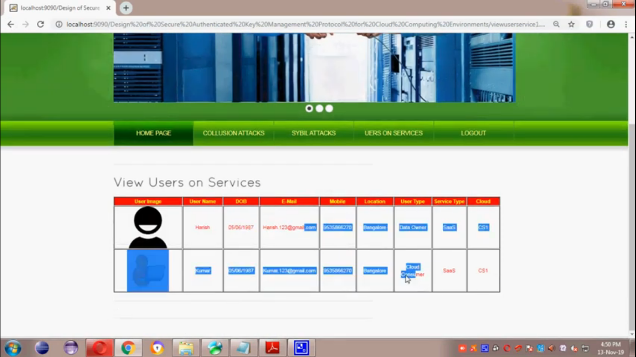
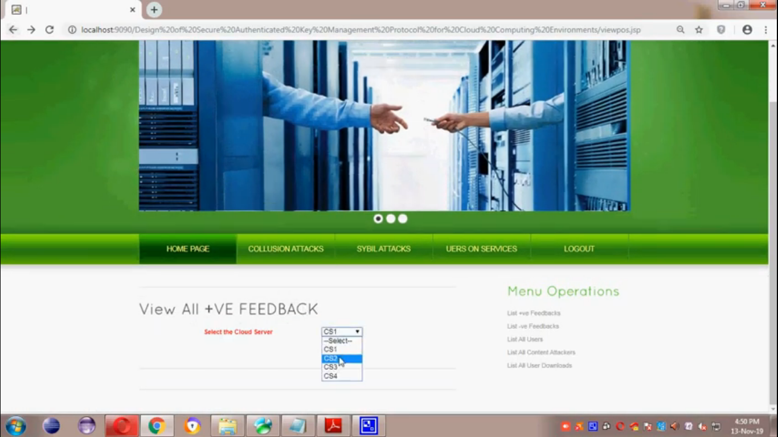
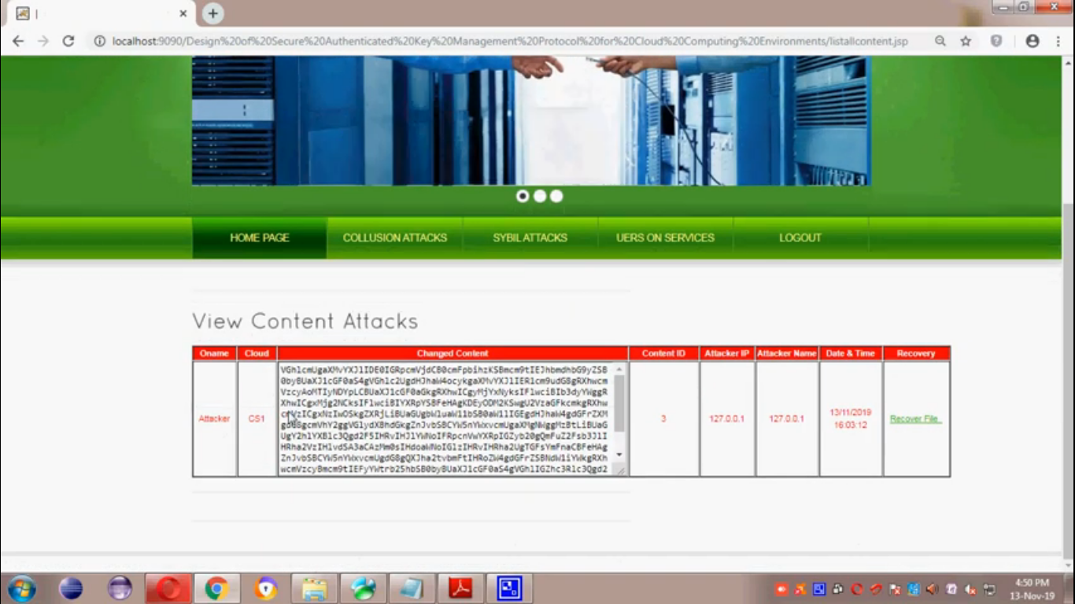
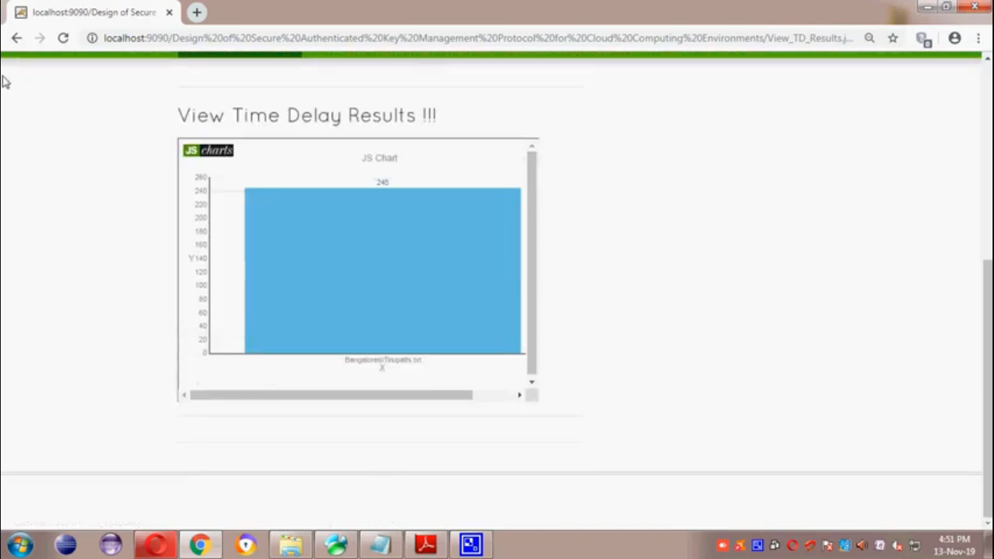

Slide 22
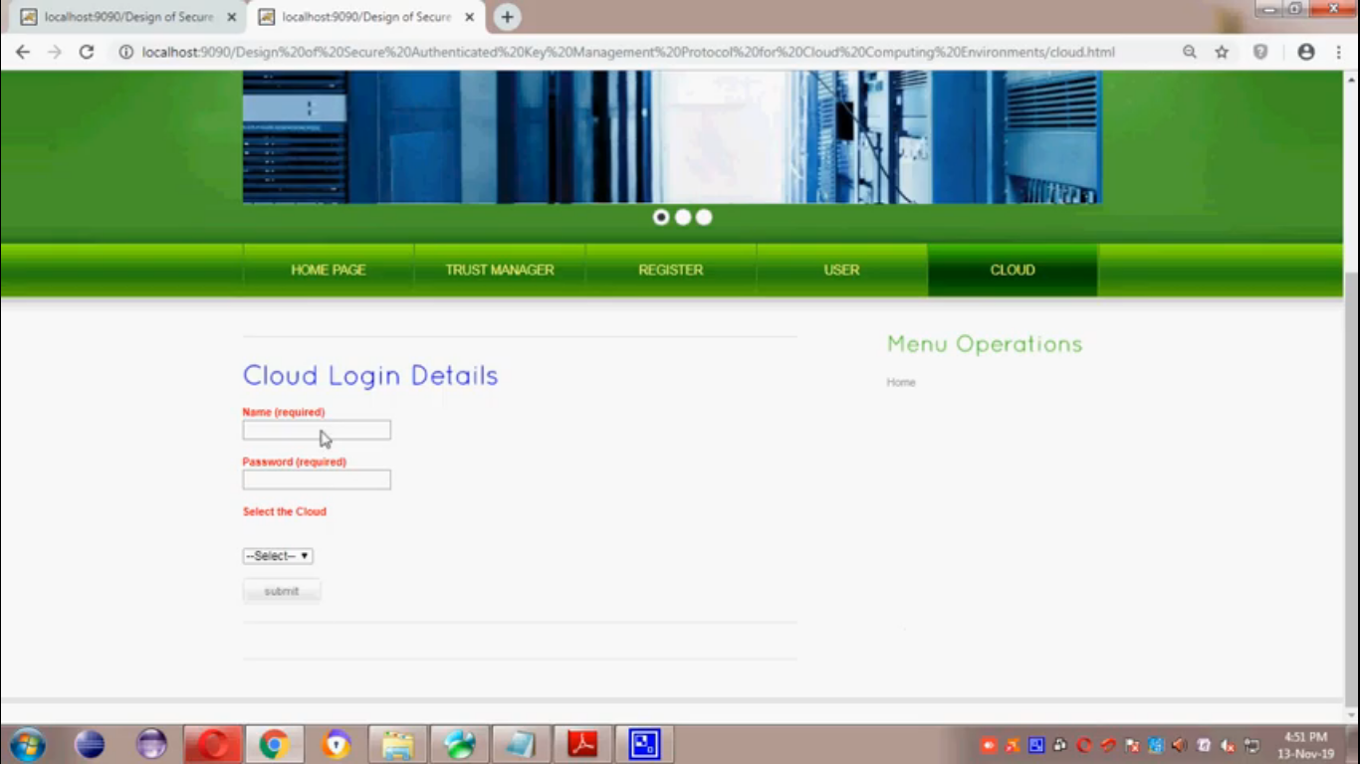
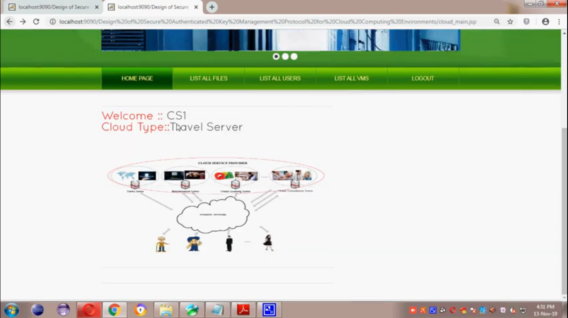

Slide 23
CONCLUSION
To resist the exhaustion of password attack on the two-factor MAKA protocols, a large number of three-factor MAKA protocols have been proposed.
However, almost all three-factor MAKA protocols don’t provide formal proofs and dynamic user management mechanism.
In order to achieve more flexible user management and higher security, this paper proposes a new three-factor MAKA protocol that supports dynamic revocation and provides formal proof.
The security shows that our protocol achieves the security properties of requirements from multi-server environments.
On the other hand, through the comprehensive analysis of performance, our protocol doesn’t sacrifice efficiency while improving the function.
On the contrary, the proposed protocol has great advantages in terms of the total computation time

Slide 24
REFERENCES
[1] J. Ronson , So You’ve Been Publicly Shamed. Picador, 2015.
[2] E. Spertus , “Smokey: Automatic recognition of hostile messages,” in AAAI/IAAI, 1997, pp. 1058–1065.
[3] S. Sood , J. Antin , and E. Churchill, “Profanity use in online communities,” in Proceedings of the SIGCHI Conference on Human Factors in Computing Systems. ACM, 2012, pp. 1481–1490.
[4] S. Rojas-Galeano , “On obstructing obscenity obfuscation,” ACM Transactions on the Web (TWEB), vol. 11, no. 2, p. 12, 2017.

